Slide 1
Using Creativity and Reflection to Empower a Diverse Learner Community
Dr. Ina Stan
Sara Eaglesfield

Slide 2
Introduction
Lecturers have the responsibility to ensure that students are empowered to navigate the Higher Education (HE) environment (Burke, 2012).
Learner diversity defines BNU's with Foundation Year (wFY) provision.
Coming from non-traditional backgrounds, many of our students may need to build their social and cultural capital to readily navigate HE.
The graduate attributes are BNU's approach to developing that capital and employability.
The wFY team created a project underpinned by the graduate attributes and informed by our learners' diversity.
The aim of our study is to explore the impact of group work on the self-efficacy of Foundation Year students at BNU.
Notes:
Ina to introduce Ina and Sara and the FY diversity and widening participation.
We are trying to achieve integration into HE, but in a way that celebrates our students' diversity, by encouraging them to draw on their own experiences and backgrounds through a project that the wFY team have created. The project aims to develop BNU's graduate attributes.
Our study explores the impact of group work on the self-efficacy of Foundation Year students at BNU. It also examines how the central modules could improve the employability and leadership development of the students, as they will allow for an understanding of how to provide appropriate assessments and how to contribute to the students’ learning experience.

Slide 3
Outline of the Presentation
BNU's graduate attribute mapping will be introduced
The wFY project will be explained
An overview of our study will be provided
Preliminary findings will be discussed under three themes:
Diversity
Creativity
Reflexivity
Notes:
Ina to provide outline

Slide 4
Buckinghamshire New University’s Graduate Attributes
‘Yellow’ Module: Leadership and Responsibility
‘Red’ Module: Knowledge and Creativity
Notes:
Sara
The BNU Graduate Attributes provide our courses with a framework for employability so that it can be embedded in all our courses at every level including foundation year.
The university, in conjunction with the Students Union, students and employers, has identified skills, qualities, attributes students will need when they graduate.
These have been embedded very explicitly within our Foundation Year's central core modules so that we can focus on empowering students to assess how they have developed their employability
We have 2 central modules which all students study in multi-disciplinary groups. Our 4 top level graduate attributes are split across these modules so that each has its own identity and purpose.
Our study focuses on our 'red' module with attributes of Knowledge and its Application and Creativity. This combination aims to develop creative thinking and approaches which can be applied to a range of problems and tasks upon which we ask students to reflect and evaluate their self-efficacy and achievements.
Bucks definition:
A set of attitudes and beliefs which influence and inform actual behaviour and performance in relation to the ability to gain and sustain meaningful work (work in the broadest sense).

Slide 5
Creativity
Commercial awareness
Production of ideas or things
Flexibility
Innovation
Problem solving
Notes:
Sara
Creativity is our first challenge: as demonstrated by these features it is not the kind of drawing and painting creativity that students expect. It is a more inclusive approach and way of thinking that can be applied within all of our disciplines.
This module teaches academic literacies and incorporates many relevant study skills but without creativity, we felt we risked leaving these skills trapped within this module.
SO

Slide 6
To implement creative pedagogy we…
Used a project
Used themes from graduate attribute to be innovative and solve problems
Group work
allows ‘students to know enough about themselves and about others so that they can work independently and yet cooperatively within a team’ (Jaque, 2000, p. 83).
Individuals brought their own experience and skills to the group work
Individual assessment using a portfolio of artefacts from each week with a reflective summary of learning
But we acknowledged that so early in wFY, group work is unstable
To overcome this we:
Did not assess group work or the final product outcome
Assessed the process and their response and reflection
Notes:
Sara
To implement a creative pedagogy it was necessary to apply the skills learned in a different and authentic context.
We were also very keen to develop teamwork.
So we use a group project for working cooperatively in a team
But group work is extremely unstable in our FY cohorts
So it was also important to allow students to work independently too
Important thing: using group work but not assessing group work
Students new so we didn’t want to rely on them working in fixed groups with specified roles so early on
Ie group membership flexible
Assessed individual work so that if (when) group work was less successful, all students still had potential to pass and pass well

Slide 7
Notes:
Sara:
The project is to research, design, prototype and test a board game on the theme of Student Life
This theme is common to all of the students but their experience at this point is limited as it is their first semester so everyone is navigating something new.
Teaching strategy
To empower students to be creative
To increase their perceived sense of self-efficacy
Encourage them to become more autonomous learners
By
Using lecturers to facilitate rather than directly teach
Start of the project – structured activities led by the lecturer
Structure is reduced during the project so that after a re-cap of the previous class, students are given the objectives for the class and they have to determine how to achieve these.
Lecturers available for guidance and reignite projects that stall
At the end of the project students present their games to the group and there is a peer review ie vote for the best game using chocolate coins
Students document the entire process in an individual portfolio and write a reflection on how this project has developed their employability
Without the tensions involved in having a group outcome assessed,

Slide 8
Overview of the Study
The data was collected between 2020-2022 as part of a research project at Buckinghamshire New University.
Data were collected from wFY students’ reflective essays and artefacts produced in class as part of a qualitative interpretive study.
Semi-structured interviews were also conducted with five former wFY students.
They were all in Level 4 at the time of the interviews.
The students came from a variety of ethnic and social backgrounds and studied different disciplines.
Notes:
Ina
For this presentation, we have used the themes extracted from the interviews and the reflective essays, but we are only discussing data from the essays and artefacts which is a subset of our research, as these are preliminary findings.
There were three men ( two white, one Black) and two women (one white and one Pakistani). One LBGTQ+
Disciplines: police studies, primary education, 3 psychology

Slide 9
Diversity
Literature Quote
Student Quote
When diversity is recognised it can magnify students’ perspectives and learning, developing their communication, critical analysis and problem-solving skills, but when it is ignored, it can lead to ‘unintentional harm to student learning’ (Sanger, 2020, p. 12).
Diversity in classrooms enhances students’ emotional intelligence, cultivates empathy and perspective-taking, enabling them to succeed personally and professionally (Early and Ang, 2003).
‘Learning to work with different people from many backgrounds greatly increased my confidence and my ability to present research that we had gathered in a group, by vocalising my findings to an audience. Putting this technique of group work and presentation into practise is going to benefit my journey as a student in the future, as what was once a daunting experience is now a part of my everyday routine in seminars.’
Notes:
Ina
Types of students in the wFY cohort:
Mature
Working
Commuting
Carers and parents
Mental health
Disabilities (Dyslexia)
Protected characteristics (ethnicity, gender, sexuality, faith)
Our interview sample was small, but diverse. There were three men ( two white, one Black) and two women (one white and one Pakistani). One LBGTQ+
In the student quote, the student is acknowledging diversity and highlighting its benefit, states that it increases confidence and develops communication, preparation for future

Slide 10
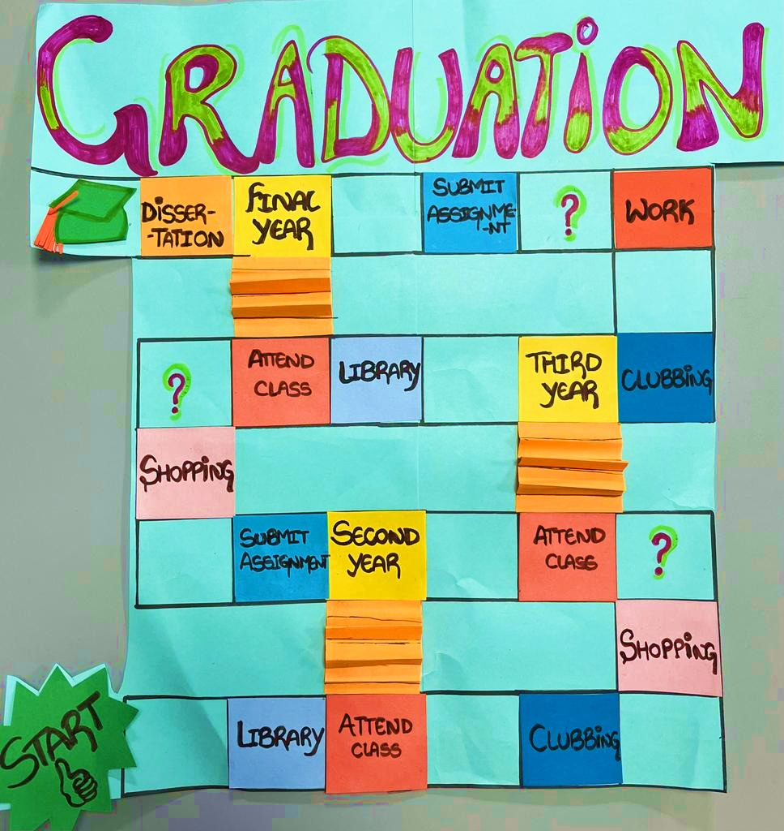
Notes:
Ina
This example illustrates how these students were already thinking about their future, and how they could achieve their final goal of graduating, by attending classes, going to the library, submitting assignments, all the while recognising the balance between studying, working and their social life. The cards associated with the question marks also focus on the future, stating things such as: 'Move to the next year' and 'Congratulations, you've reached dissertation'.
This board game was produced by two Nigerian female students and an Indian female student.

Slide 11
Creativity
Literature Quote
Student Quote
Experiential learning practices enable learners to feel and see themselves within the topics explored, question their beliefs and who they ‘Other’ (Le Bourdon, 2022).
Creative thinking skills enable students to engage in a more flexible and faster problem-solving process (Whetten and Cameron, 2011).
Developing creativity, critical thinking, and problem-solving skills in higher education positively impacts students’ academic success (Almulla, 2023).
‘ The Games Design project provided me a creative approach and also the opportunity to work with a multicultural team, which is the point that I will focus on. As I have always been involved in the world of the arts, the area of creativity is something natural for me. However, with this project I faced some challenges in teamwork and how I should deal with each member of the group.’
Notes:
Sara
Student quote illustrates how they see themselves within the topic
Diversity/experiential learning – multi-cultural team
‘Other’ – challenges in team work and highlights individuality in the team
Starting to move beyond more conventional ideas of creativity ie 'the world of the arts' towards creativity in thinking and approaches, in this case to benefits and challenges of working in a multi-cultural team whilst recognising the individuality within

Slide 12
Student Loan!
Collect £200
Head of Department
Student Union
Computer Library
Takeaway Shop
Clothes Shop
Library
Incentive
Gym
Consequences
Pub
UNIOPOLY
Consequence
Train Station
Incentives
Societies
Consequence
Student Housing
Incentive
Coffee Shop
Lecture Hall
Club
Go To Head of Department
Amazon
Free Bus Service
Notes:
Sara
Uniopoly, clearly a derivative of Monopoly with a variety of locations around the board reflecting aspects of Student Life with Student Loan replacing Go, the Free inter-campus bus service replacing free parking and Head of Department replacing Jail.
More granular detail of their experience lies within the Incentives and Consequences cards.
Incentives:
You have received a bursary from the university! Collect £300
You've been sent money for your birthday! Collect £20
You have leftover Thai Food for tomorrow! Food Shop Exemption Card
The university has held a freshers' fair and you have received discounts and freebies! Collect your student loan
Consequences:
Rent is due! Pay £150
You haven't been attending seminars! Move back 3 spaces
Food shop! Pay £50
You plagiarised! Go straight to Head of Department. Do not collect student loan
This example illustrates the importance of students’ social life alongside their academic one.
The quote highlight incentives and consequences of engagement with the project
Consequences – not participating – sitting apart, not talking – not achieving
Incentive – being to share ideas and produce an innovative and exciting outcome

Slide 13
Reflexivity
Literature Quote
Student Quote
‘Reflexivity is seen as a key part of a learner's journey in global education, a continuous process of self-examination and life-long learning’ (Le Bourdon, 2022, p. 3).
Emphasis here is on empowering learners to be the agents for change through reflecting on how they can see and engage in the world differently (Le Bourdon, 2022, p. 3).
‘The board game did not seem to be very useful to me initially, however, after a sober reflection on the second lesson, I then identified an effective impact on me. Being in groups where each group had the same goal – creating games. I had the confident to communicate and socialize with my fellow mates which was difficult for me initially as everyone was sitting apart without greetings or pleasantry; I came to realize the importance of teamwork as everyone in the group was contributing effectively from a different perspective and bring up innovative ideas; thus, respecting another people’s opinions.’
Notes:
Ina
Student quote
Students often complained that they could not see how the board game was relevant for them and their discipline. This was the case for this student. However, the quote demonstrates that reflection empowered the student – they realised that the board game enabled them to set goals and develop communication and teamworking skills – key to achievement and relates to the graduate attributes. This is why we ask students to write a reflective summary at the end of the project, which is marked, rather than marking the board game project itself. Although the artefacts produced during the project are marked through a portfolio.
Graduate attribute mapping and reflective summary

Slide 14
Notes:
Ina
Our example demonstrates a clear focus on money and negative consequences. Students' thought processes around the importance of academic life and the realities of being a student are evident. There does not appear to be much focus on academic life on the board, but the win and lose cards explicitly reference FY assignments and classes.
Lose cards: 'You have failed to complete your portfolio pay £100'; 'You have failed your assignment pay £200.'
One lose card specifically shows respect for others: 'You are late to class. Pay each player £40 for disturbing them.'
Win cards: 'You have passed your assignment. Collect £200.' 'You have been working really hard. Collect £100.

Slide 15
Reflexivity – our teaching practice
Literature Quote
What are we doing?
‘Teachers, too, are encouraged to critically reflect on their own beliefs and teaching in global education (Hicks and Holden, 2007), not only to prevent bias in teaching but as they, too, are continuously transforming through unlearning and learning.’ (Le Bourdon, 2022, p. 3)
Mandatory training
Team Meeting discussions
Disseminating information from seminars, reading groups, journal articles, conferences
Examples:
Inclusive language, micro-aggression
Reflection on our practice using Listening Rooms case study (Heron and Parkin, 2023)
Notes:
Ina and Sara
Sara: Team briefings – these have become the glue holding the team together where we discuss
the teaching resources
how students respond to them
problems that might emerge in class
Assignments
Effective – from the types of problems shared; questions asked; everyone participates
Opportunities for more structured reflection
JLDHE Journal of Learning Development in Higher Education
Special Edition, Equality, Diversity and Inclusion
Listening rooms to explore diversity – we used the findings and recommendations as a way to evaluate our wFY provision
Ina: Team members attend regular meetings as part of BNU’s Decolonization Reading Group, as well as training events on inclusive language and micro-aggressions.
The reading group has definitely informed my teaching practice, as it made me more aware of ensuring that I am inclusive during my seminar, that I listen and encourage everyone to contribute by creating a safe environment where everyone's opinion matters.
When deciding what readings we include in our curriculum, we make sure that we consider our students' diversity, so we have a reading on the St. Vincent and Grenadine community in High Wycombe, we have Mikey's story from the Humans of New York blog, who was a former drug dealer turned into ice-cream parlor owner, trying to improve his community.

Slide 16
Conclusion
We used a case study of a project within a wFY module to show how wFY:
Supports diversity by valuing students' individuality and background
Enables students to navigate HE
Develops employability through creativity and reflexivity
The board game has become a metaphor for the integration and navigation of HE within their lives.
Notes:
Sara
As the players move around the board they are navigating their HE environment – locations around the university; milestones such as deadlines and goals such as progression to new levels and ultimately graduation.
The academic features are perhaps a little naïve and under-developed or under-represented compared to other activities.
However, this is a reflection of how new these students are to wFY and their studies. They are still finding much of their common ground in things that lie outside of their studies – clubbing, shopping, nights out.
Their board designs demonstrate that the integration of new experiences and requirements into their existing lives is occurring.

Slide 17
References
Almulla, A.M. (2023) ’Constructivism learning theory: A paradigm for students’ critical thinking, creativity, and problem solving to affect academic performance in higher education’, Cogent Education, 10(1), pp. 1-25. DOI: 10.1080/2331186X.2023.2172929
Burke, P. J. (2012) The Right to Higher Education: Beyond Widening Participation. London and New York: Routledge.
Earley, P.C. and Ang, S. (2003) Cultural Intelligence: Individual Interactions Across Cultures. Stanford: Stanford University Press.
Heron, E. and Parkin, H.J. (2023) ‘Listening works: using the listening rooms methodology to explore diversity’, Journal of Learning Development in Higher Education, 26, pp. 1-13.
Le Bourdon, M. (2022) ‘Confronting the discomfort: a critical analysis of privilege and positionality in development’, International Journal of Qualitative Methods, 21, pp. 1-8. DOI: 10.1177/16094069221081362.
Sanger, C.S. (eds.) (2020) ‘Diversity, Inclusion, and Context in Asian Higher Education’, in Sanger, C.S. and Gleason, N.W. (eds.) Diversity and Inclusion in Global Higher Education: Lessons from Across Asia. Singapore: Palgrave Macmillan. pp. 1-28.
Whetten, D. A., and Cameron, K. S. (2011) Developing management skills. 9th edn. Hoboken, NJ: Prentice-Hall/Pearson.

Slide 18
Any questions?

Slide 19
Notes:
Sara
This example may appear very simple, but there are consequences depending on the role of the dice. There are cards that include either negative, positive or a mixture of consequences, such as....

