Slide 1
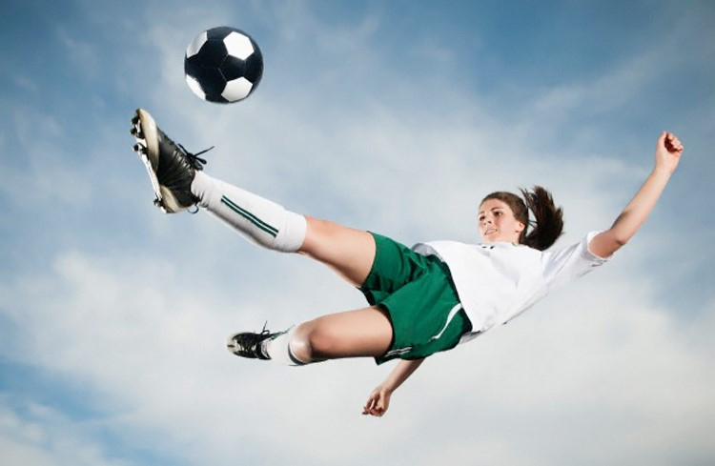
Female Football Players Don’t Eat Enough!
Can we develop an intervention which changes behaviour?
Phil Woodbridge MSc BA(Hons) SENr

Slide 2
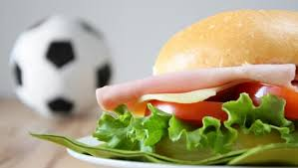
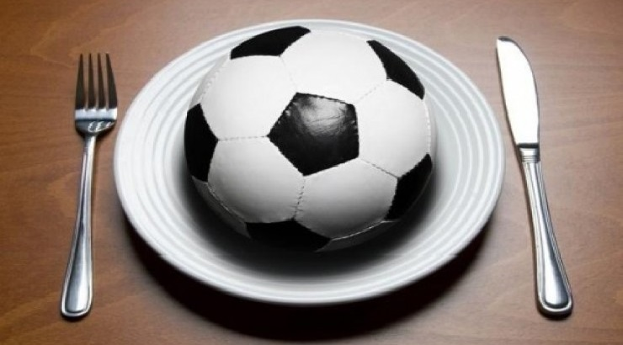
Research Questions?
What do female football players eat?
What injuries are sustained?
Nutritional interventions and impact?

Slide 3
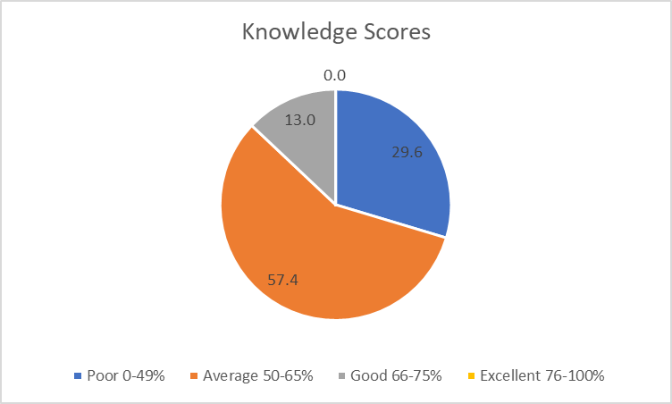
Study 1 Results
Don’t eat enough
Sports Nutrition Knowledge Poor
Significantly weak positive relationship between knowledge and energy intake
LEAF-Q Score – 43% below threshold
Notes:
Weak positive correlation but education alone is insufficient to change behaviour

Slide 4
Study 2 Objectives
Increase nutritional knowledge
Improve nutritional intakes
Improve symptoms and injury scores

Slide 5



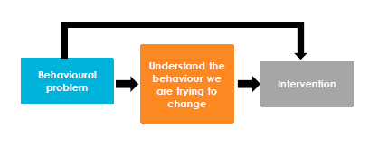
Study 2 Design

Slide 6
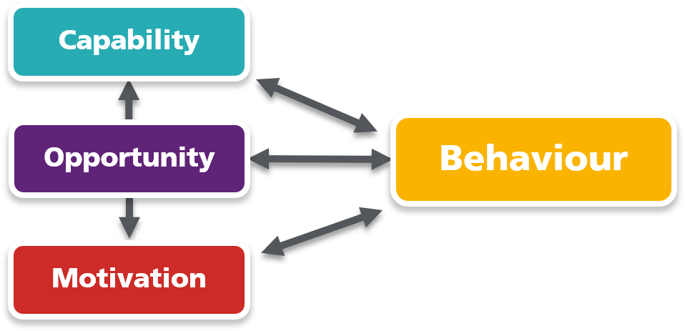
The COM-B Model
Notes:
Complex and multi-facetted. Detect barriers to nutritional adherence. Develop evidence-based interventions

Slide 7
Stages of the Behaviour Change Wheel
Identifies appropriate intervention strategies
Clear, simple and accessible
Behaviour change techniques (BCTs) - intervention functions
Notes:
BCTs building blocks of the intervention functions the activities that make change happen. 93 BCTs 16 groups only 19 used! APEASE used to assess support function selection, affordable, practical, effective, acceptable, safe and equity!

Slide 8
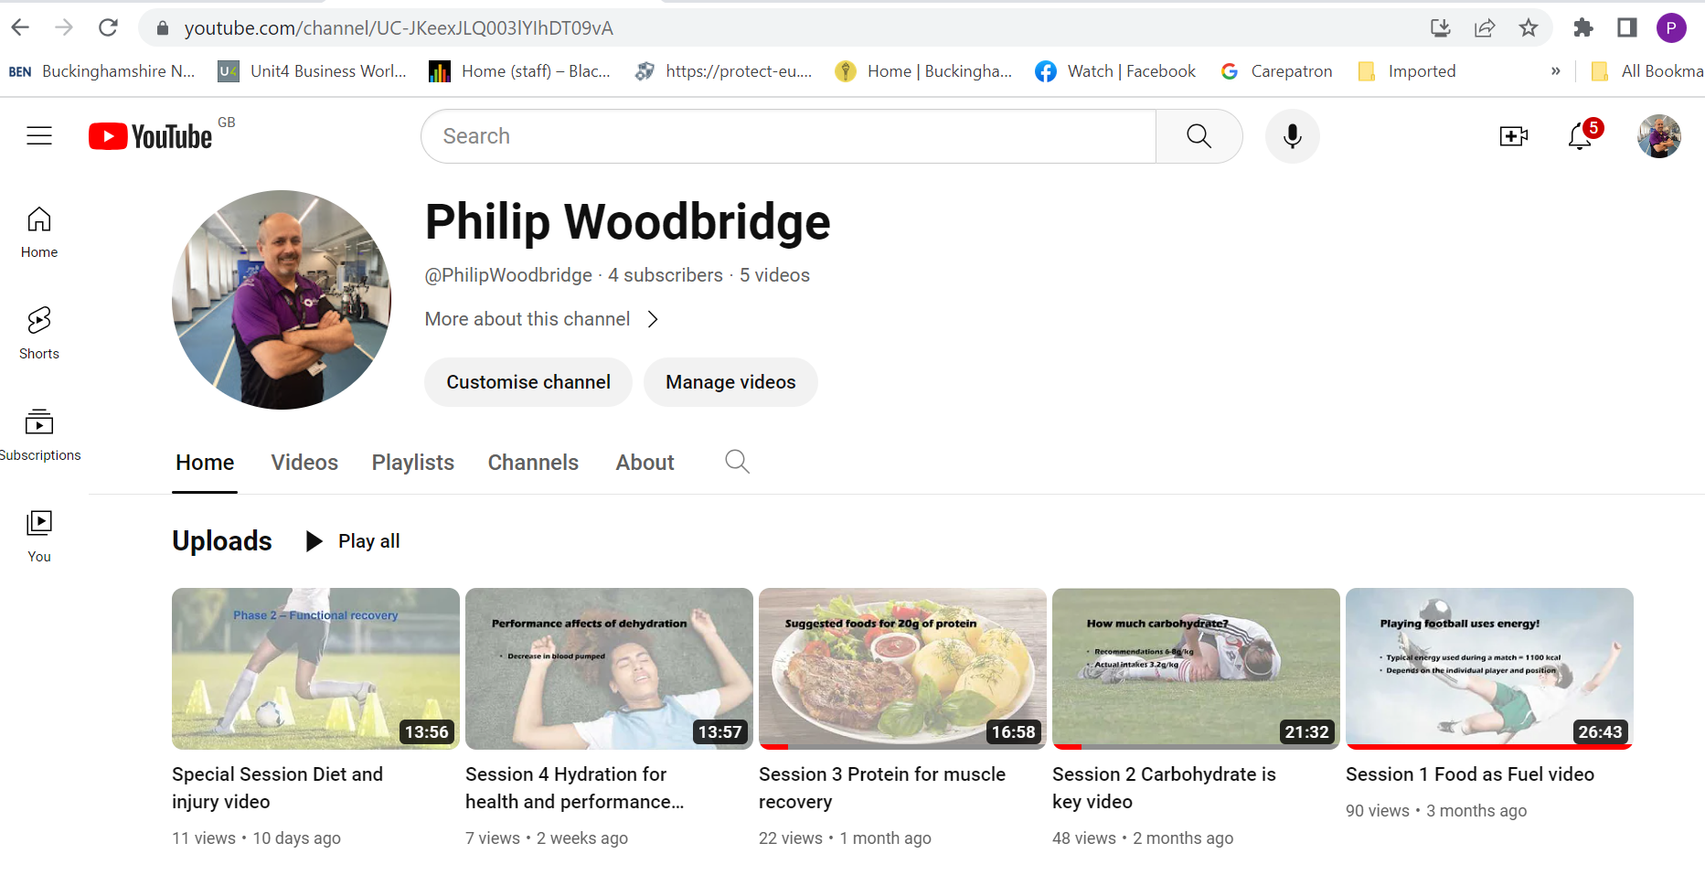
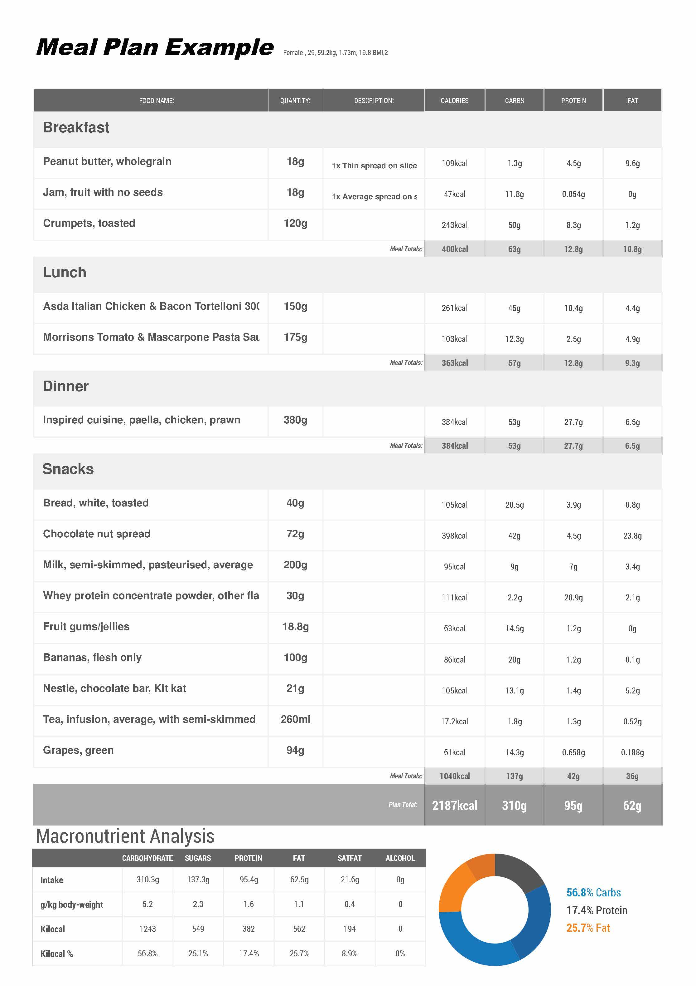
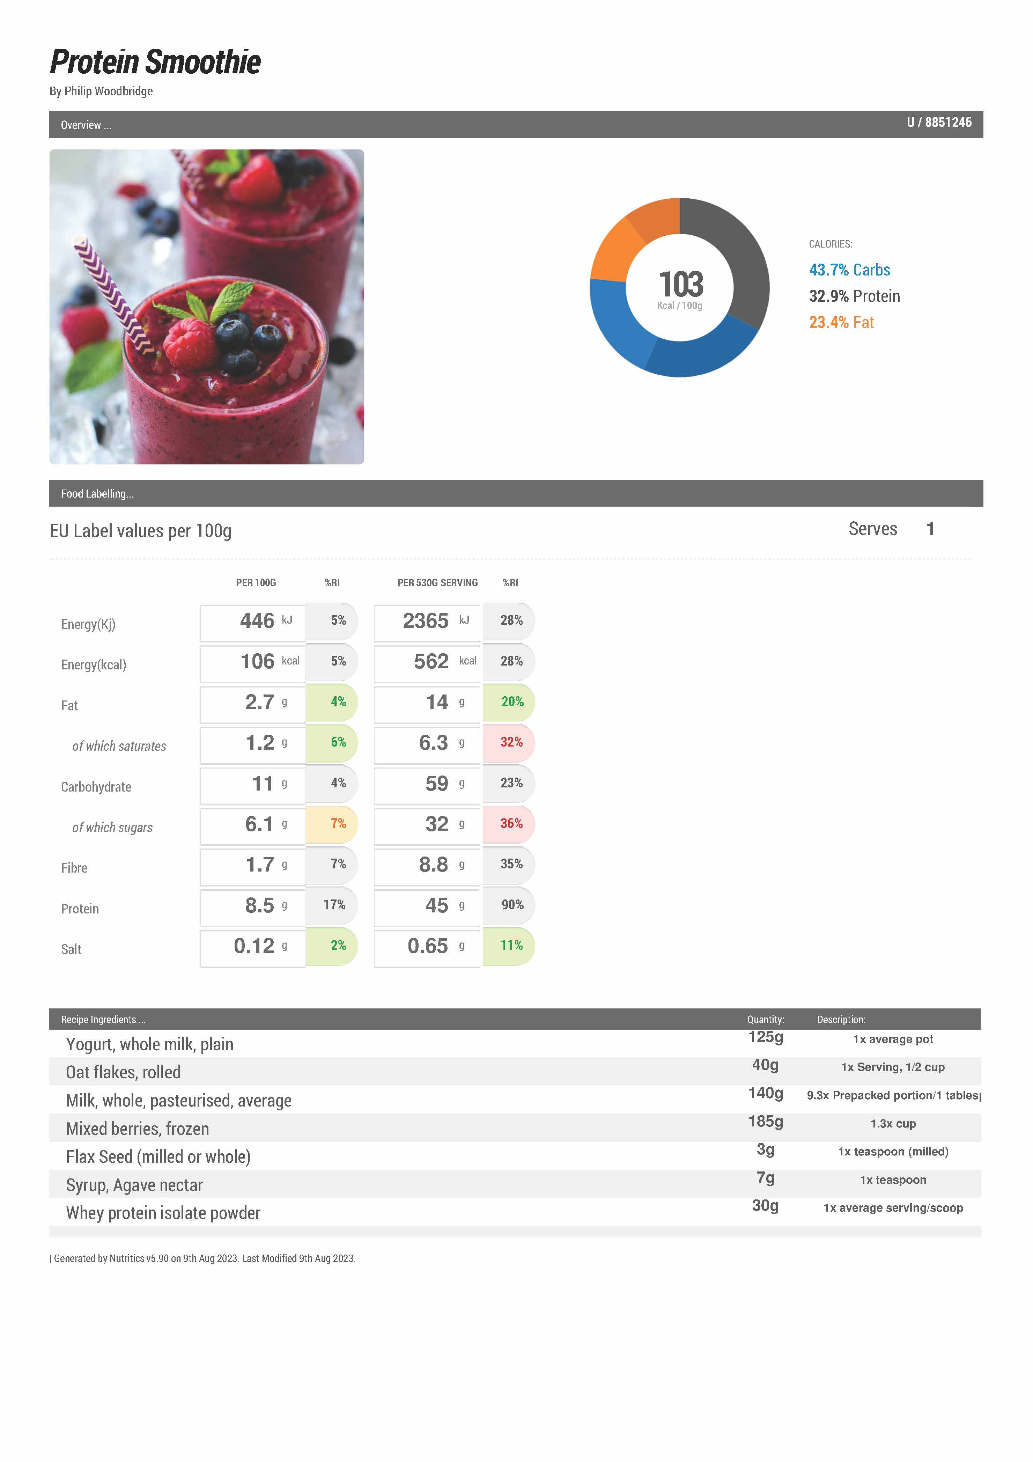
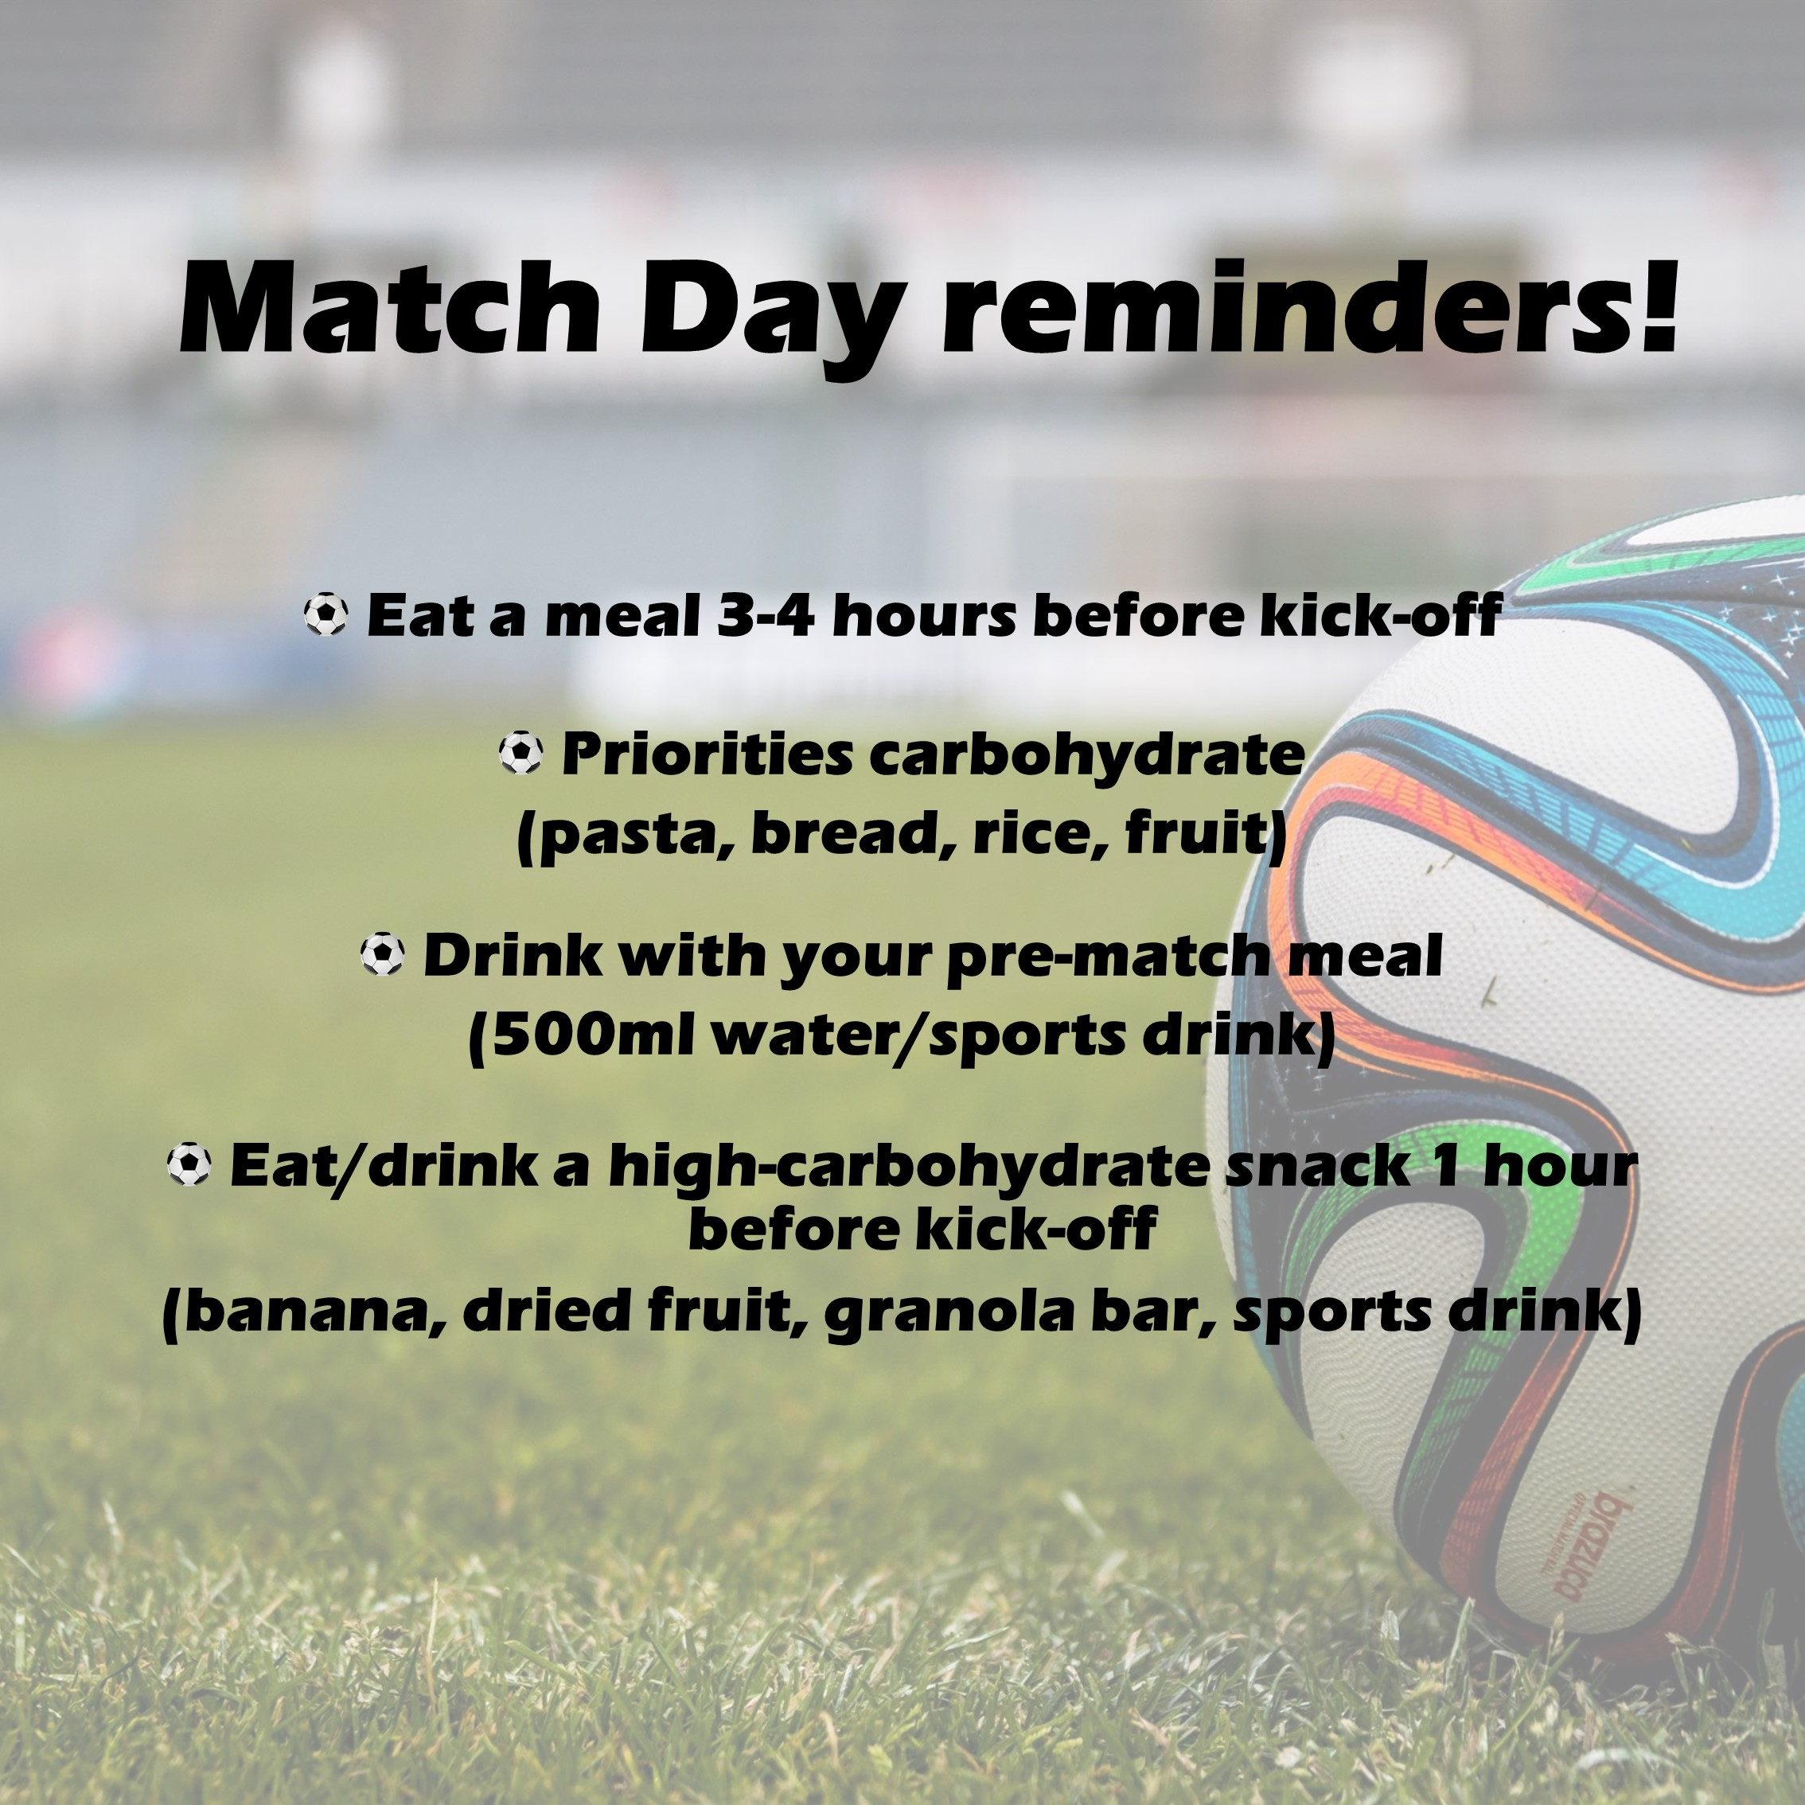
Changing Capability
Education – YouTube videos,
Education - Hints and tips
Training - Recipes
Enablement – Meal Plans

Slide 9
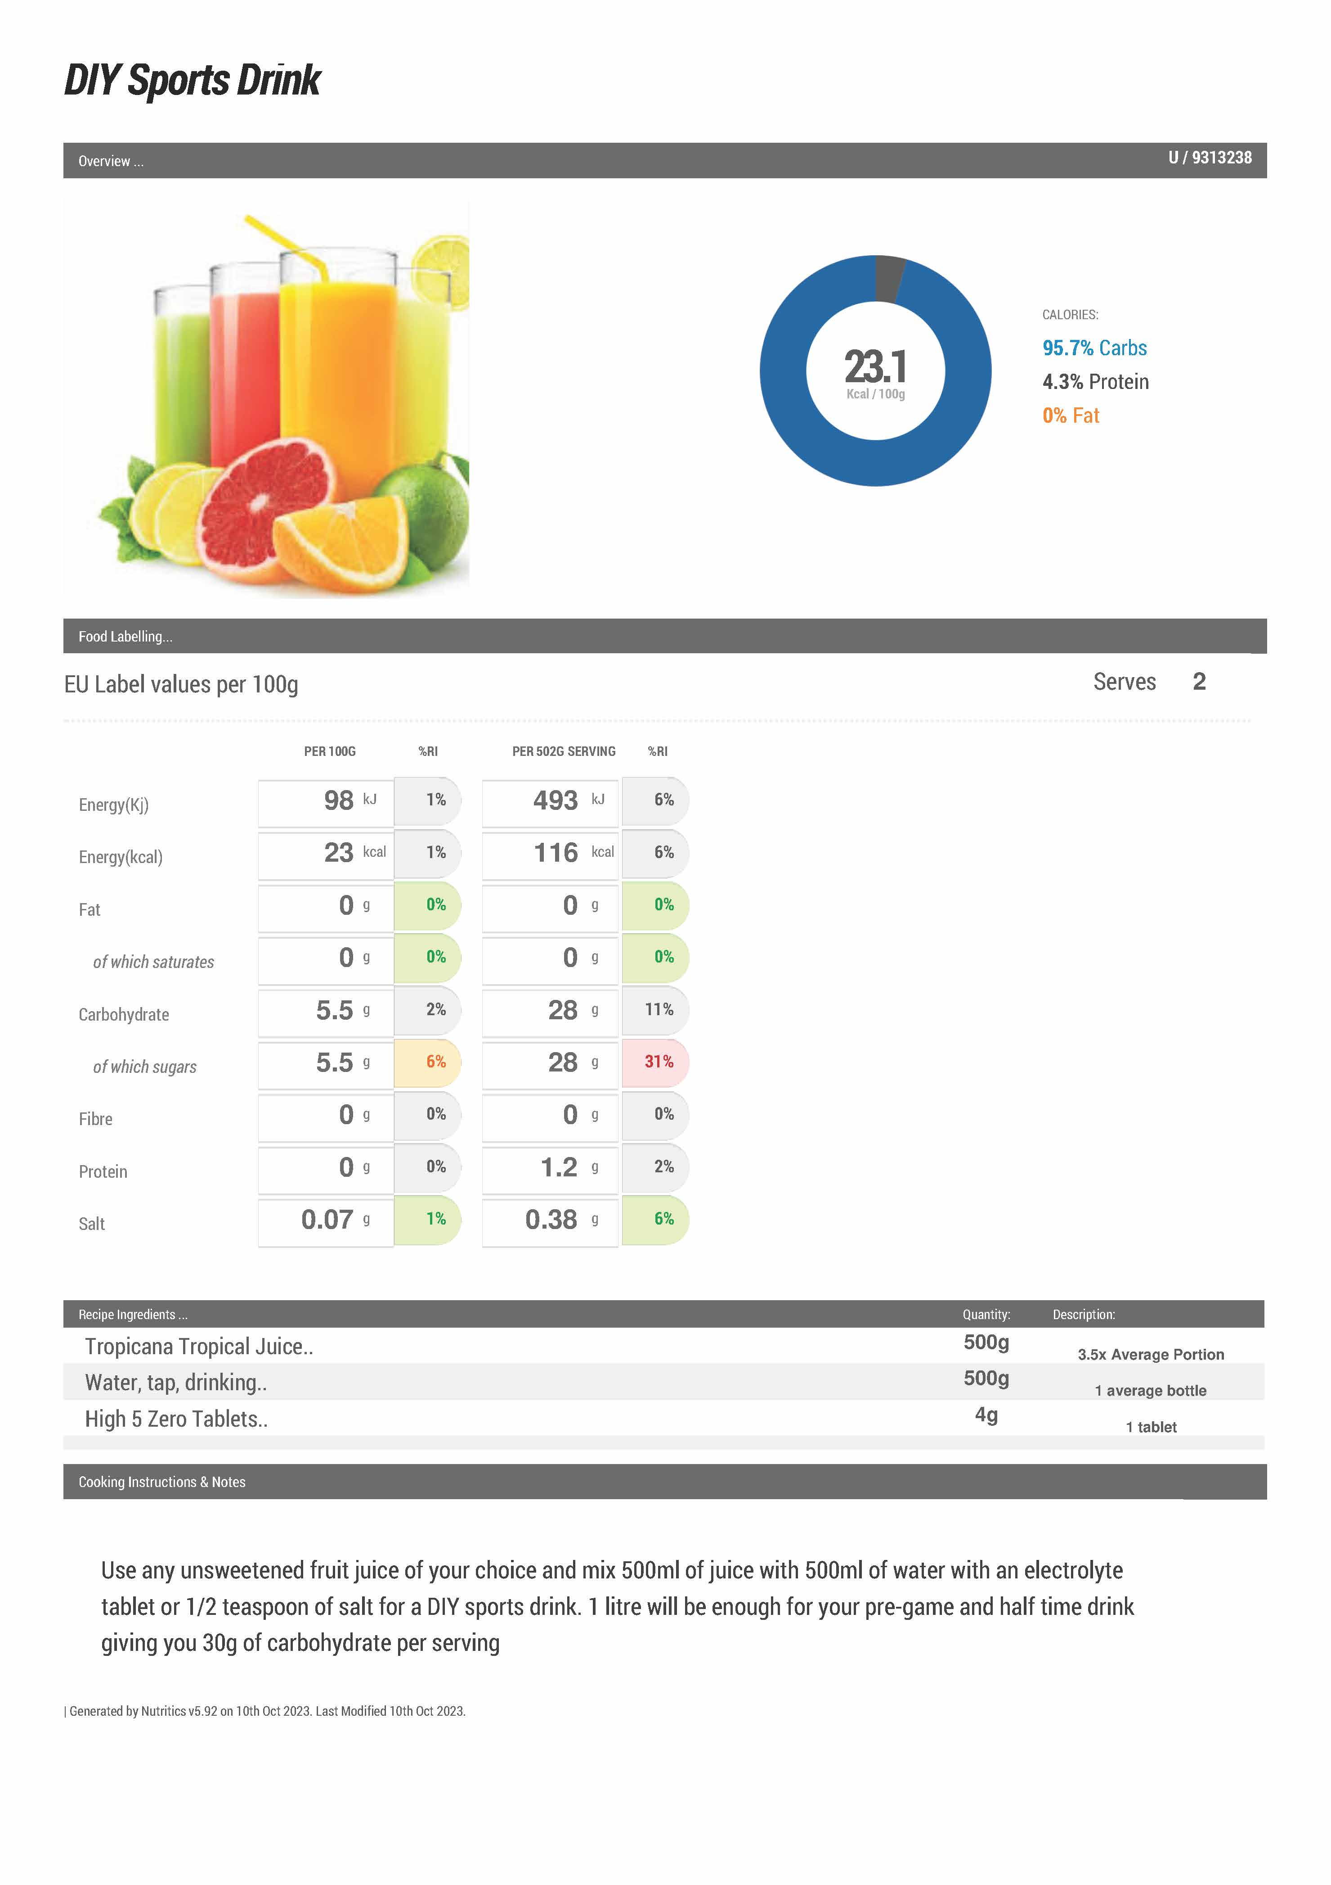
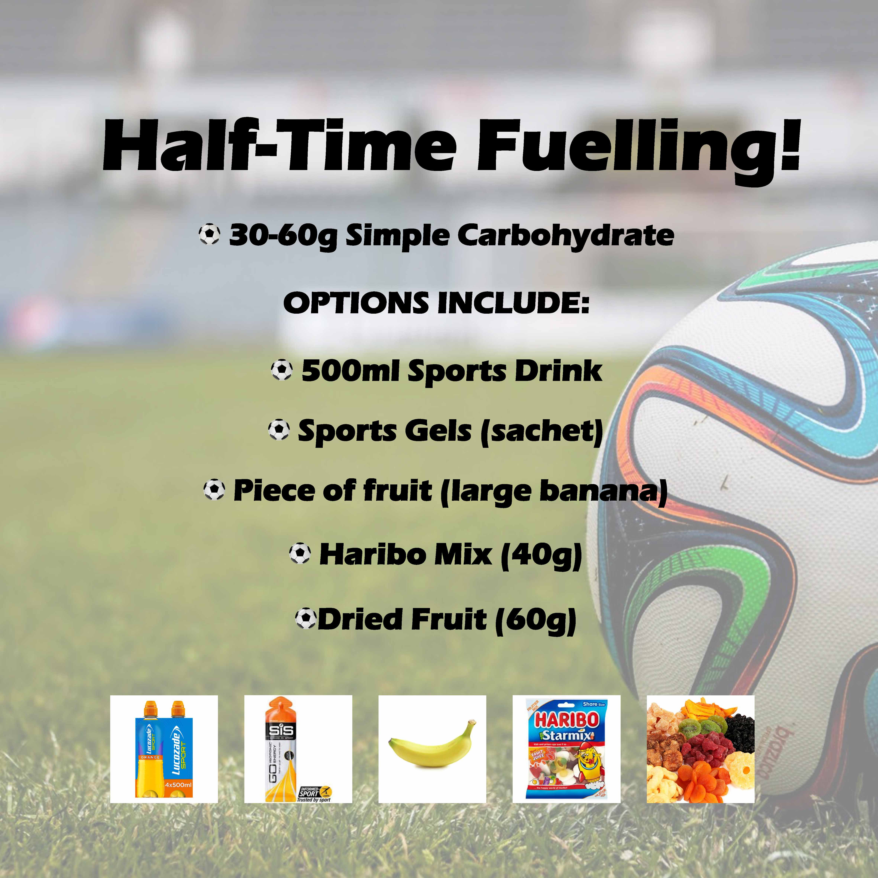
Changing Opportunity
Environment Restructuring – Pre-match
Training – Half-time suggestions
Enablement – Availability at games
Notes:
Busy lives , busy jobs, travelling as barriers. Snacks/drinks suggestions. Store cupboard essentials Parents involved (meal plans and recipes)

Slide 10
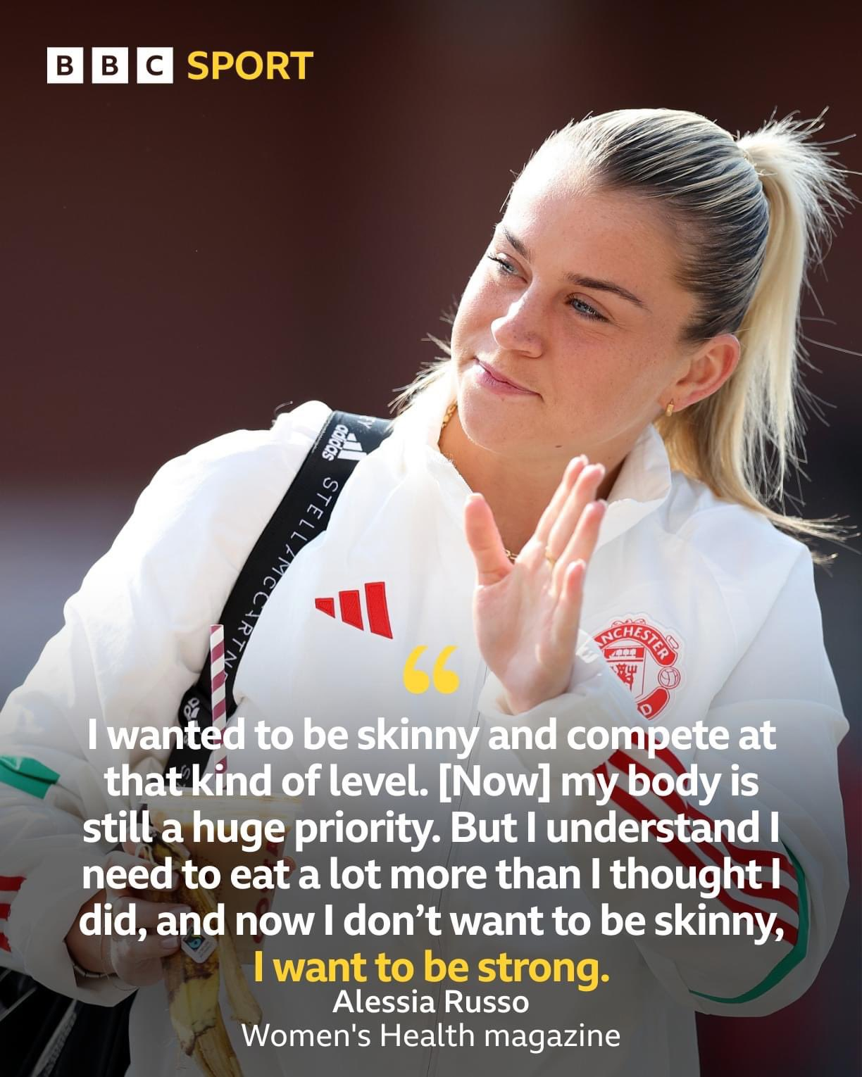
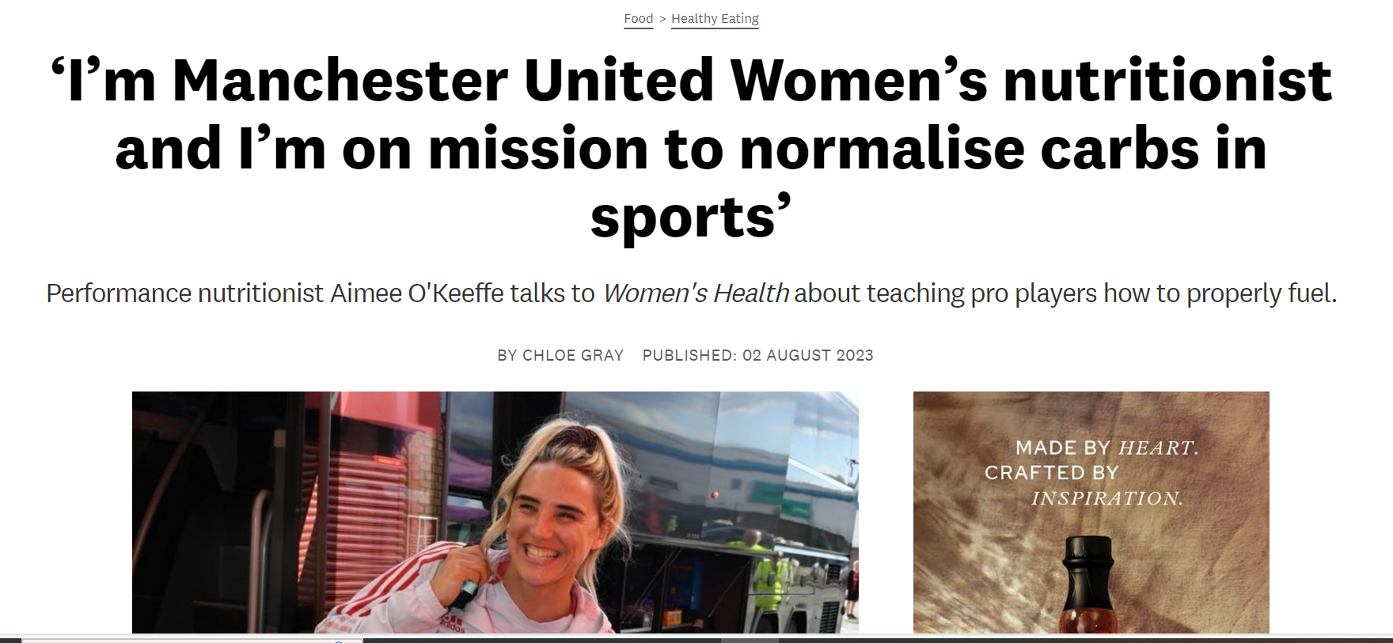
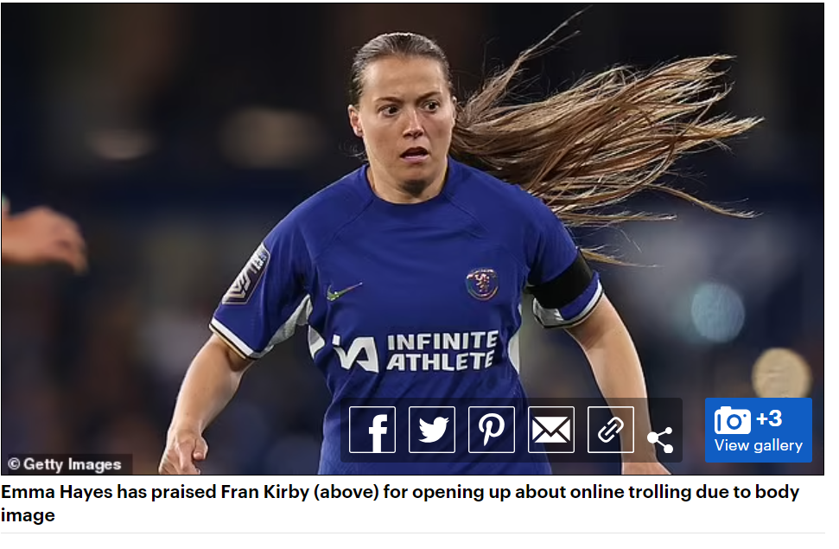
Changing Motivation
Persuasion – motivational examples
Education – aspirational examples
Training – weekly emails
Environmental restructuring – availability
Attendance at games
Notes:
Recent Fran Kirby issue with fat shaming plus Emma Hayes from Chelsea WSL team speaking out about the issue and stigma around nutrition in women’s football. "It [nutrition] should be something that should be championed to be strong and if that means you have to eat more, you're doing the things your body needs not just because of how you look on camera."
Coaches and parents included for motivation

Slide 11
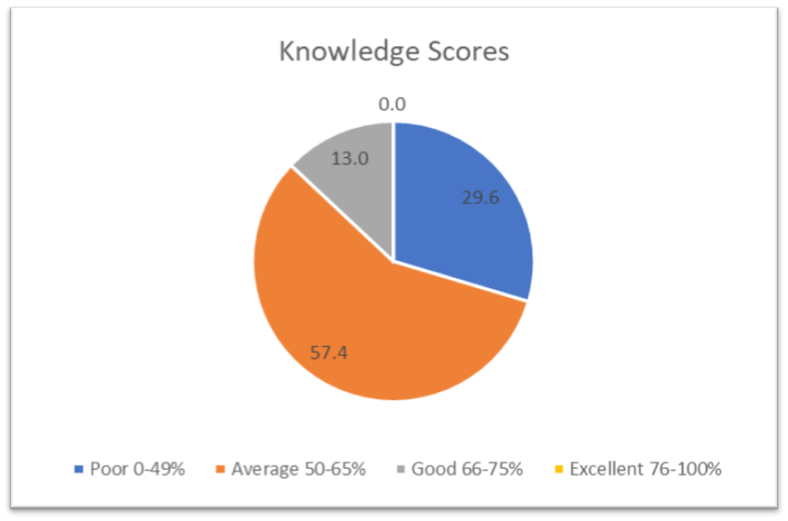
Study 2 Results
Increased Nutrition Knowledge
Poor 30% to 10%
Good or excellent 13% to 20%

Slide 12
Study 2 Results
Increased Energy Intake
Increased Energy Availability
Reduced Energy Deficit
LEAF-Q Score 43% to 35%

Slide 13
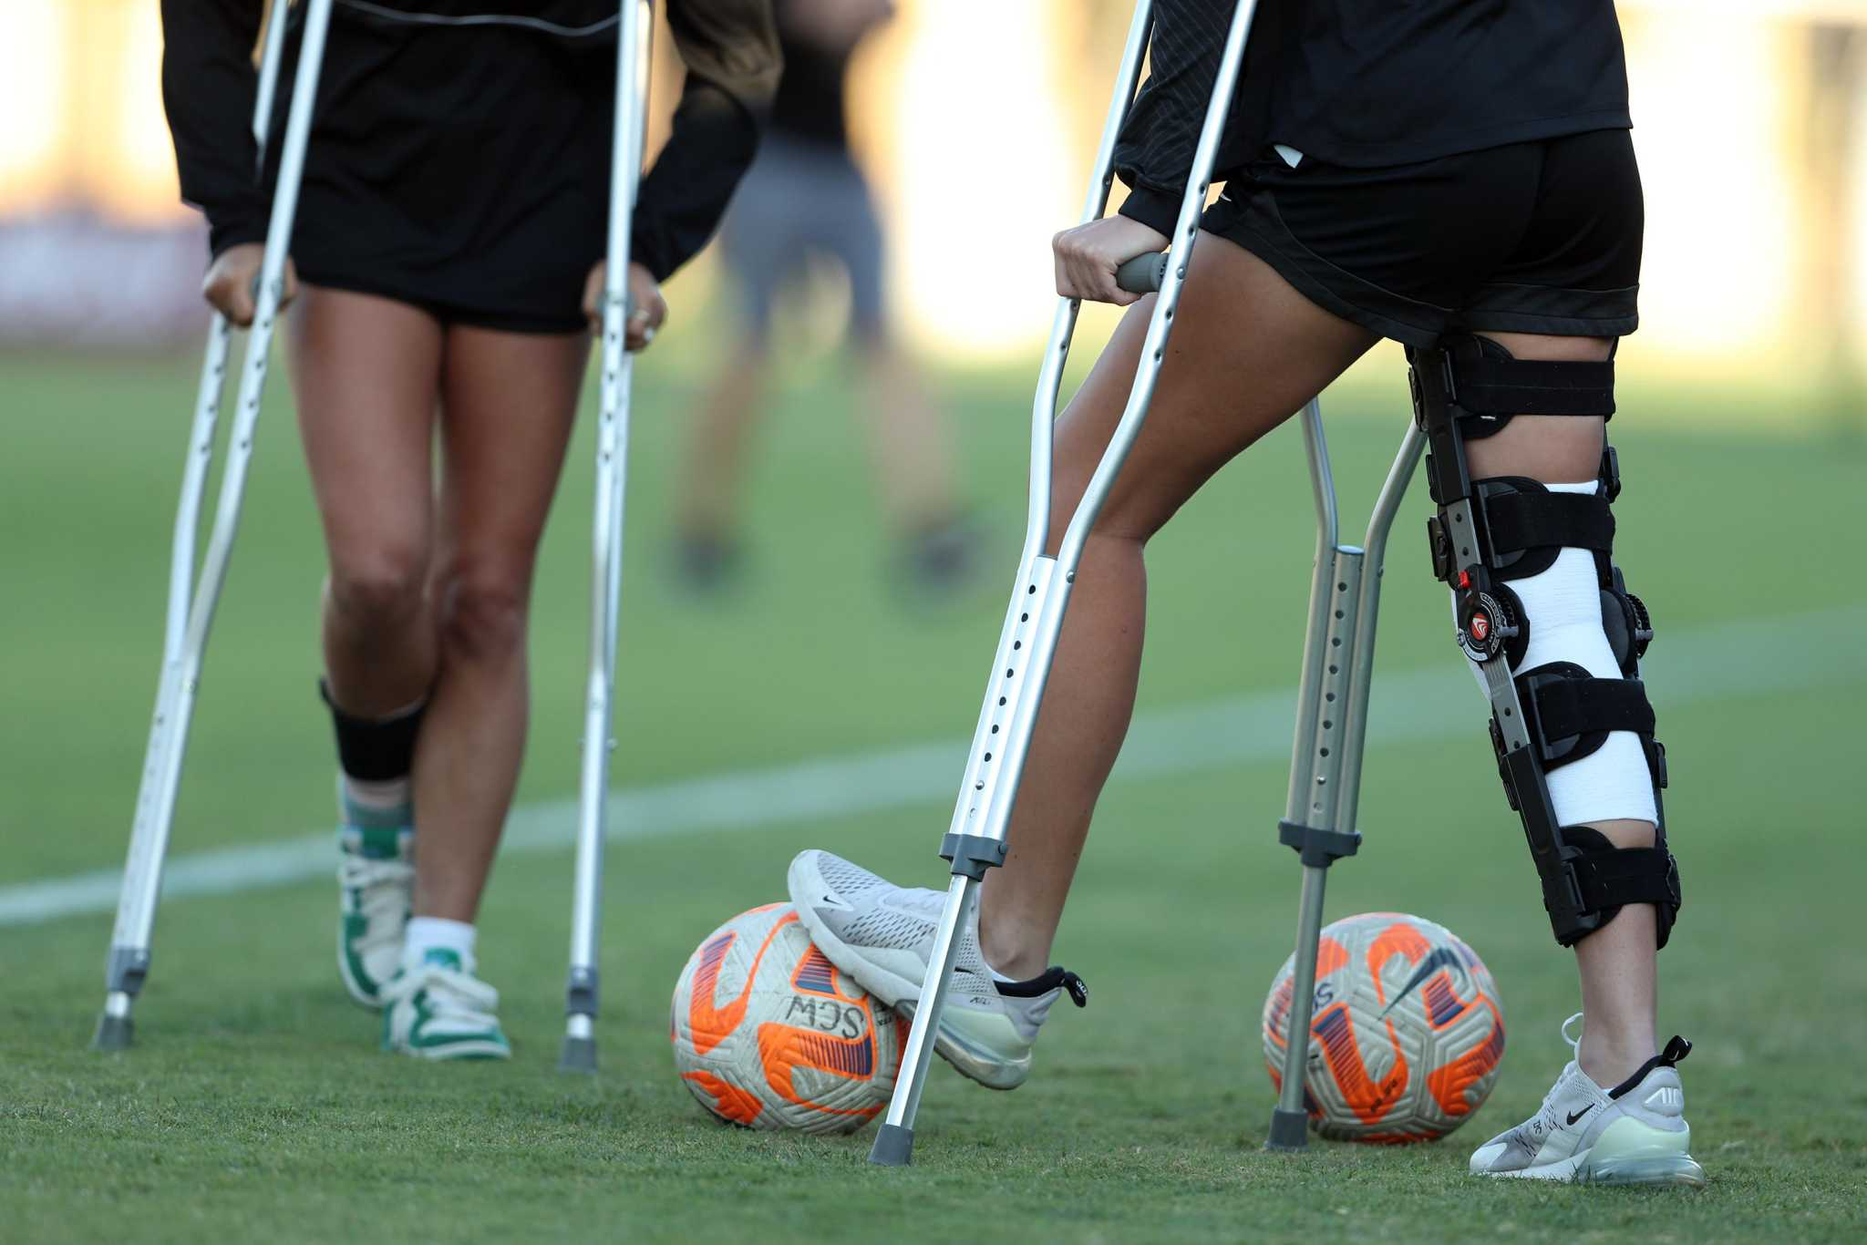
Significant or not?
MANCOVA – EI, Knowledge, LEAF-Q covariant Age
(F= .555, p=.647)
Partial eta Squared – Small effect size (.027)
Energy Intake – Small effect size (.322)
LEAF-Q – Small effect size (-.186), Injury (-.256)
Knowledge – Moderate effect Size (.469)
Energy availability – Moderate effect size (.432)
Carbohydrate Intake – Moderate effect size (.419)
PRACTICAL OR ECOLOGICAL SIGNIFICANCE??

Slide 14
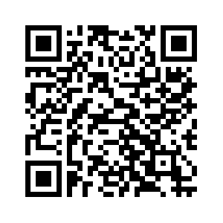
QUESTIONS?

